Slide 1
Ch06 Inputs, outputs and files
6.8 Reading and Writing CSV Format Files
6.9 Object Serialization
6.10 os module and file directory operations
6.11 Standard Inputs, Outputs, and Error Flows
6.12 Redirection and Pipelines
6.13 Integrated applications: statistics and analysis of document data
Highlights of the chapter:
6.1 Input and Output Overview
6.2 Command Line Parameters
6.3 Standard Input and Standard Output Functions
6.4 Files and file objects
6.5 Reading and Writing Text Files
6.6 Reading and Writing Binary Files
6.7 Reading and Writing Random Files

Slide 2
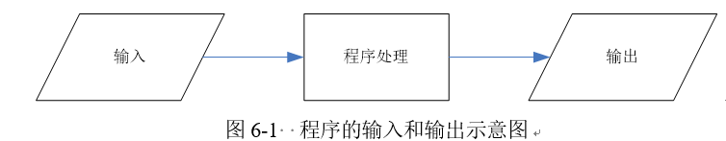
Inputs and outputs overview
Python programs can usually implement interactive features using one of the following methods:
(1) Command line parameters.
(2) Standard input and output functions.
(3) File input and output.
(4) Graphical User Interface

Slide 3
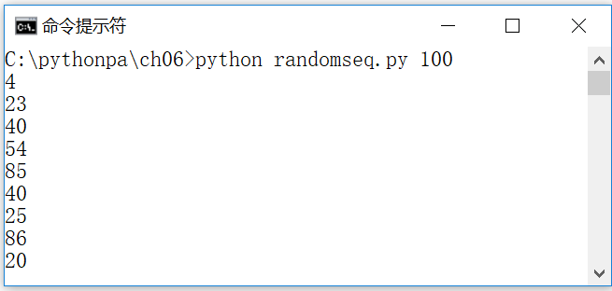
command-line parameter
Access to command line arguments via list sys.argv
argv[0] is the Python script name, argv[1] is the 1st argument, argv[2] is the 2nd argument
[Example 6.1] Example command-line argument (randomseq.py): generate n random numbers, where n is determined by the first command-line argument of the program
import sys, random
n = int(sys.argv[1])
for i in range(n):
print(random.randrange(0,100))

Slide 4
The argparse module and command line parameter parsing
The argparse module is a standard python module for parsing named command line arguments to generate help messages
Basic steps for using the argparse module
(1) Import module
>>> import argparse
(2) Create ArgumentParser object
>>> parser = argparse.ArgumentParser()
(3) Call the parser object method add_argument() to add the command argument information to be parsed
>>> parser.add_argument('--length', default=10, type=int, help='length')
(4) Call the parser object method parse_args() to parse the command line arguments and generate the corresponding list
>>> args = parser.parse_args()
>>> args # Output: Namespace(length=10)

Slide 5
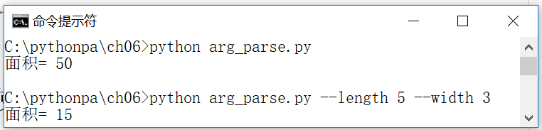
[Example 6.2] Command Line Parameter Parsing Example
Parses the values of length and width entered in the command line arguments, and calculates and outputs the area of the rectangle.
import argparse #Import modules
parser = argparse.ArgumentParser() #create ArgumentParser object
parser.add_argument('--length', default=10, type=int, help='length') #Length of the rectangle, default=10
parser.add_argument('--width', default=5, type=int, help='width') #Width of rectangle, default=5
# Call the parser object method parse_args() to parse the command line arguments and generate the corresponding lists
args = parser.parse_args()
area = args.length * args.width # Calculate the area of the rectangle
print('area=', area) #Output the area of the rectangle

Slide 6
Standard Input and Standard Output Functions
Format of the input function
Format of the print function
The print function is used to print a single line, i.e. multiple values (value, ...) separated by a separator (sep, defaults to space), to a specified file stream (file, defaults to console sys.stdout). value, ..., comma-separated values), written to the specified file stream (file, the default is the console sys.stdout). The argument end specifies a newline character; flush specifies whether to force writing to the stream.

Slide 7
[Example 6.3] Input and Output Functions Example 1 (io_test1.py)
>>> print(1,2,3) # Output with default separator (spaces). Output: 1 2 3
1 2 3
>>> print(1,2,3,sep=',') # Output with comma (,) separator. Output: 1,2,3
1 2 3
>>> print(1,2,3,sep=',',end='. \n') # Output with comma separators, ending with a dot and a line feed
1,2,3.
>>> for i in range(5): # Output with spaces instead of newlines.
print(i, end=' ')
0 1 2 3 4

Slide 8

[Example 6.4] Input and Output Function Example 2 (io_test2.py)
import datetime
sName = input("Please enter your name:") #Input Name
birthyear = int(input("Please enter your birth year:")) #Input birth year
age = datetime.date.today().year - birthyear #Calculate age based on current year and birth year
print("Hello! {0} You are {1} years old." .format(sName, age))

Slide 9
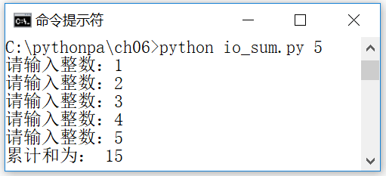
[Example 6.5] Reading n integers from the console and calculating their cumulative sum (io_sum.py)
n is determined by the first command line argument of the program
import sys
n = int(sys.argv[1]) # first argument on the command line confirms the number of integers to be summed n
sum = 0 #Set the initial value of the sum = 0
for i in range(n):
number = int(input('Please enter an integer:')) #Input an integer
sum += number #Accumulate integers
print('The cumulative sum is:', sum) #Output n integer cumulative sums

Slide 10
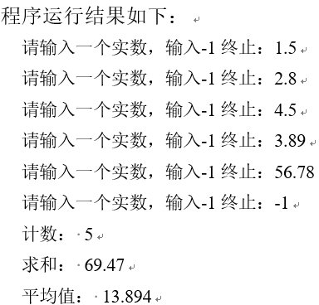
Interactive user input
[Example 6.6] Write a program (stat.py) that inputs a batch of data (assuming that the input is terminated when -1 is entered), counts the number of data entered, and finds the sum and the average.
a=[] #initialize the list
x=float(input("Please enter a real number, enter -1 to terminate:"))
while x ! = -1.
a.append(x) # add the entered real numbers to the list
x=float(input("Please enter a real number, enter -1 to terminate:"))
print("Count: ", len(a)) #List length is the number of real numbers
print("Summing: ", sum(a)) #Sum the elements of the list
print("Average: ", sum(a)/len(a)) #Average the elements of the list

Slide 11
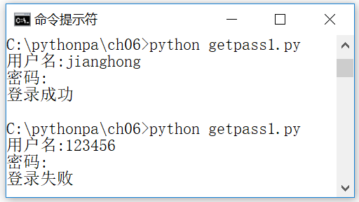
Prompt for password when running
[Example 6.7] Prompting for a password at runtime (getpass1.py)
import getpass
username = input("username:") #prompt for username
passwd = getpass.getpass("Password:") #Prompt for a password
if username == 'jianghong' and passwd == 'password': # In practice, it needs to be compared with the account information in the database.
print('Login successful')
else.
print('Login failed')

Slide 12
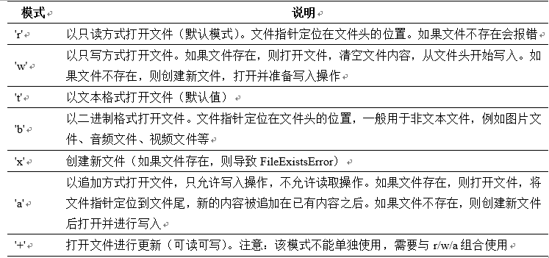
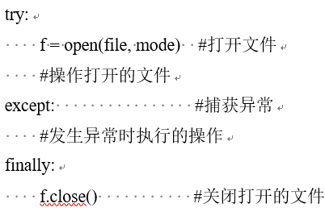
Files and file objects
File objects and the open function
You can specify the mode of opening a file when using the open() function

Slide 13
File opening, writing, reading and closing
The built-in function open creates or opens a file object.
You can write strings to a text file using the write/writelines instance method of the file object.
You can read the contents of a text file by using the instance method read/readline of the file object.
Once the file has been read or written, it should be closed using the close method

Slide 14
[Example 6.8] Reading and outputting a text file (type_file.py)
import sys #import module
filename = sys.argv[0] # read and output that is the program file
f=open(filename, 'r', encoding='utf8')#open file (read mode, specify encoding)
line_no=0 #Statistical line number
while True:
line_no += 1 #Line number counting
line = f.readline() #read line information
if line.
print(line_no, ":", line) #Output the line number and the contents of the line
else.
break
f.close() # close the open file

Slide 15


The with statement and context management protocol
Objects that implement the context management protocol
The file object supports the use of with statements to ensure that open files are automatically closed.
[Example 6.9] Reading and outputting a text file using the with statement (type_file_with.py)
import sys
filename = sys.argv[0] # what is read and output is the program file type_file_with.py
line_no=0 #Statistical line number
with open(filename, 'r', encoding='utf8') as f: #Implement the context management protocol using the with statement
for line in f:
line_no += 1 #Line number counting
print(line_no, ":", line) #Output the line number and the contents of the line

Slide 16
Text file writing
Opening files, writing data and closing files
1. Create or open file objects
The built-in function open() allows you to create or open file objects, specifying the overwrite mode (when the file exists), encoding and cache size.
2. Write a string to a text file
After opening the file, you can use its instance methods write()/writelines() to write strings to the text file. You can use its example method flush to force the buffered data to be updated to the file.
f.write(s) #write the string s to the file f
f.writelines(lines) #Write each string in the list lines to the file f in turn
f.flush() #Update the buffered data to the file
3. Closure of documentation
When writing to the file is complete, the stream should be closed using the close method to free up resources and update the buffered data to the file
f.close() # close the file

Slide 17
[Example 6.10] Example of writing a text file
with open(r'c:\pythonpa\data1.txt', 'w') as f.
f.write('123\n') #write string
f.write('abc\n') #write string
f.writelines(['456\n', 'def\n']) #write string

Slide 18
Text file reading
Opening files, reading data and closing files
1. Open the file object
File objects can be opened with the built-in function open(). Encoding and cache size can be specified. Example:
f1=open('data1.txt', 'r') #open data1.txt, if the file doesn't exist, it causes FileNotFoundError
2. Reading character data from an open text file
After opening the file, you can read the character data using the following example methods.
f.read(): reads the rest of the contents from f up to the end of the file, returning a string.
f.read(n): read up to n characters from f, return a string; if n is negative or None, read until the end of the file.
f.readline(): read 1 line from f, return a string.
f.readlines(): reads the remaining multiple lines from f and returns a list.
3. Closure of documentation
Streams can be closed using the close method to free up resources. Usually a with statement is used to ensure that the system automatically closes open streams

Slide 19
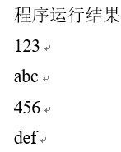
[Example 6.11] Text File Reading Example
with open(r'c:\pythonpa\data1.txt', 'r') as f.
for s in f.readlines()::
print(s, end='')

Slide 20
Reading and writing binary files
When using the open() function to open or create a file, you can specify the open mode as 'b' to open a binary file
1. Create or open file objects
Binary file objects can be created or opened by the built-in function open(), specifying the open mode 'b'. The overwrite mode (when the file exists) and the cache size can be specified. Example:
f1=open('data1.dat', 'wb') #create or open data1.dat
2. Write byte data to binary file
After opening the file, you can use its instance method write to write byte data (bytes or bytearray) to the binary file. The example method flush can be used to force the buffered data to be updated to the file. The relevant commands are listed below:
f.write(b) #write byte data b to binary file f, return the actual number of bytes written
f.flush() #update the buffered data to the file
3. Closure of documentation
Streams can be closed using the close method to free up resources. Usually a with statement is used to ensure that the system automatically closes open streams

Slide 21

Example of reading and writing binary files
[Example 6.12] Writing a Binary File
with open(r'c:\pythonpa\data1.dat', 'wb') as f.
f.write(b'123') #write byte data
f.write(b'abc') #write byte data
[Example 6.13] Reading Binary Files
with open(r'c:\pythonpa\data1.dat', 'rb') as f.
b = f.read()
print(b)

Slide 22
Randomized document access
Create or open random files
Use the built-in function open() to specify the open mode '+'
localization
Use its instance method seek to locate
Write/Read Data
Use its example method write/read
Close file
Use the close method to close the stream to free up resources

Slide 23

[Example 6.14] Example of reading and writing a random file
import os
f=open('data.dat', 'w+b') #create or open the file data.dat
f.seek(0) #Locate to the start position
f.write(b'Hello') #write byte data
f.write(b'World') #write byte data
f.seek(-5, os.SEEK_END) #Locate to the end position penultimate position
b = f.read(5) #read 5 bytes
print(b) #Output: b 'World'

Slide 24
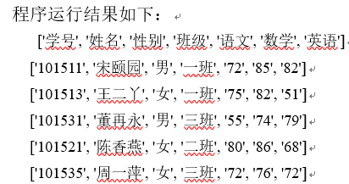
Reading and writing CSV file format (1)
Comma-delimited text formatting
csv.reader object and csv file reading. This section is based on the following scores.csv file with the contents:
[Example 6.15] Reading a csv file using the reader object
学号,姓名,性别,班级,语文,数学,英语
101511,宋颐园,男,一班,72,85,82
101513,王二丫,女,一班,75,82,51
101531,董再永,男,三班,55,74,79
101521,陈香燕,女,二班,80,86,68
101535,周一萍,女,三班,72,76,72
import csv
def readcsv1(csvfilepath).
with open(csvfilepath, newline='') as f: #open the file
f_csv = csv.reader(f) #create csv.reader object
headers = next(f_csv) #headers
print(headers) #print headers (list)
for row in f_csv: # Loop to print each row (list)
print(row)
if __name__ == '__main__'.
readcsv1(r'scores.csv')

Slide 25
Reading and writing CSV file format (2)
csv.writer object and csv file writing
[Example 6.16]: Writing a csv file using the writer object
import csv
def writecsv1(csvfilepath):
headers = ['Student number', 'Name', 'Gender', 'Class', 'Language', 'Math', 'English']
rows = [('101511', 'Song YiYuan', 'Male', 'Class 1', '72', '85', '82'),
('101513', 'Wang Erma', 'Female', 'Class 1', '75', '82', '51')]
with open(csvfilepath,'w', newline='') as f: #open file
f_csv = csv.writer(f) #create csv.writer object
f_csv.writerow(headers) #write 1 line (headers)
f_csv.writers(rows) #write multiple rows (of data)
if __name__ == '__main__'.
writecsv1(r'scores1.csv')

Slide 26
object serialization
Also known as serialization, objects are converted to data form and dumped to disk files or transferred across platforms over a network
Deserialization: the process of recovering from a disk data file or a received data form to obtain the corresponding object.
Using the functions provided in the pickle/cPickle module, you can serialize Python objects

Slide 27
[Example 6.17] Object serialization
import pickle
with open(r'c:\pythonpa\dataObj1.dat', 'wb') as f.
s1='Hello!'
c1=1+2j
t1=(1,2,3)
d1=dict(name='Mary', age=19)
pickle.dump(s1, f)
pickle.dump(c1, f)
pickle.dump(t1, f)
pickle.dump(d1, f)

Slide 28
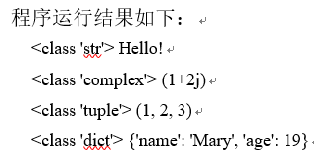
[Example 6.18] Object Deserialization
import pickle
with open(r'c:\pythonpa\dataObj1.dat', 'rb') as f.
o1=pickle.load(f)
o2=pickle.load(f)
o3=pickle.load(f)
o4=pickle.load(f)
print(type(o1), str(o1))
print(type(o2), str(o2))
print(type(o3), str(o3))
print(type(o4), str(o4))

Slide 29
json module and JSON format data (1)
json module is similar to the pickle module, can also be achieved object serialization, and can be achieved with other languages to achieve the program to achieve data exchange
JSON (JavaScript Object Notation) defines a standard format for describing typical built-in objects (such as dictionaries, lists, numbers, and strings) in strings. Although JSON was originally a subset of the JavaScript programming language, it is now a language-independent data format, and all major programming languages have libraries for producing and consuming JSON data.
JSON is one of the popular formats for web data exchange

Slide 30
json module and JSON format data (2)
The Python standard library module json contains functions for encoding Python objects into the JSON format (JSON for short) and for decoding JSON into Python objects:
dumps(obj): return to serialize the obj object to JSON string.
dump(obj, fp): serialize the obj object into a JSON string and write it to the file fp.
loads(s): return the object after deserializing the JSON string s.
load(fp): return the object deserialized from the JSON string read from the file fp.
>>> import json
>>> data = [{'a': 'A', 'b': (2, 4), 'c': 3.0}]
>>> str_json = json.dumps(data)
>>> str_json #Output: '[{"a": "A", "c": 3.0, "b": [2, 4]}]''
>>> data1 = json.loads(str_json)
>>> data1 #Output: [{'a': 'A', 'c': 3.0, 'b': [2, 4]}]

Slide 31
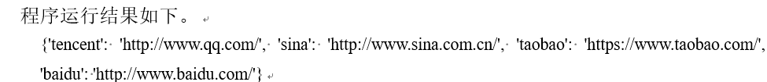
json module and JSON format data (3)
[Example 6.19] Object JSON format serialization example (json_dump.py)
import json
urls={'baidu':'http://www.baidu.com/',
'sina':'http://www.sina.com.cn/',
'tencent':'http://www.qq.com/',
'taobao':'https://www.taobao.com/'}
with open(r'c:\pythonpa\data.json', 'w') as f.
json.dump(urls, f)
[Example 6.20] Object JSON format deserialization example (json_load.py)
import json
with open(r'c:\pythonpa\data.json', 'r') as f.
urls = json.load(f)
print(urls)

Slide 32
os module and file directory operations
Using the os module in the standard library, users can implement the operating system's directory processing, such as creating directories, deleting directories, and other operations.
The os module mainly consists of the functions getcwd() (to get the current working directory), chdir() (to switch the current working directory), mkdir() (to create a single-level directory), makedirs() (to create a multilevel directory), listdir() (to display a list of files/subdirectories in a directory), rmdir() (to remove a directory), remove() (to remove a file) and rename() (to rename a file or directory). remove(), and rename() (rename a file or directory).
[Example 6.21] File Directory Operation Example
>>> import os #Import modules
>>> os.getcwd() # show current directory
>>> os.chdir(r "c:\pythonpa") #Switch current directory
>>> os.listdir(r "c:\pythonpa") #list the contents of the current directory

Slide 33
Standard inputs, outputs and error streams
Use the sys module's sys.stdin, sys.stdout, and sys.stderr to view the corresponding standard input, standard output, and standard error stream file objects
[Example 6.22] Standard Output Stream Example
>>>import sys
>>>print("An error message", file=sys.stdout) #Output: An error message
>>>sys.stdout.write("Another error message\n")
Another error message
22

Slide 34
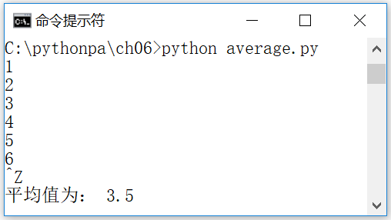
Read an input stream of arbitrary length
[Example 6.23] Calculating the average of values in an input stream (average.py)
import sys
total = 0.0
count = 0
for line in sys.stdin:
count += 1
total +=float(line)
avg = total / count
print("The average value is: ",avg)

Slide 35
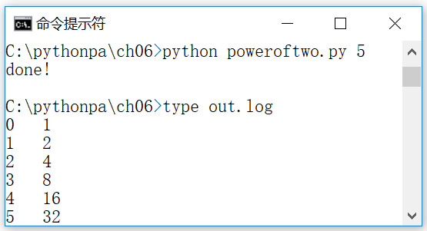
Standard input, output and error stream redirection
[Example 6.24] Standard output stream redirection example (poweroftwo.py). Get the value of n from the first argument on the command line, then print out a list of 0 to n and 0 to n powers of 2 to the out.log file
import sys
n = int(sys.argv[1]) #Get the value of n from the first argument on the command line
power = 1 #0 to the nth power of 2 assigned initial value
i = 0 # count to initial value
f = open('out.log', 'w') #Specify that standard output is redirected to the file out.log
sys.stdout = f
while i <= n.
print(str(i), ' ', str(power)) #Output a list of 0~n and 0~n powers of 2
power = 2 * power #Calculate 0 to the nth power of 2
i = i + 1 # count plus 1
sys.stdout = sys.__stdout__
print('done!')

Slide 36

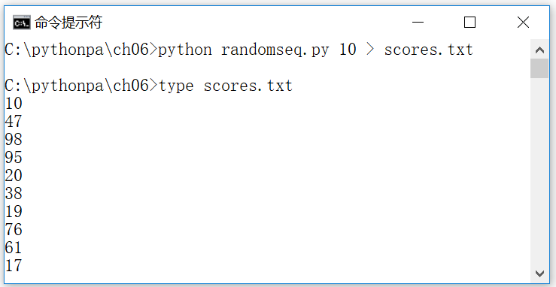
Redirection and Pipelines
Implement an abstraction of standard input and standard output and specify different sources for standard input or standard output through the operating system
Redirecting standard output to a file
[Example 6.25] Redirecting Standard Output to a File
Command line command: python randomseq.py 10 > scores.txt
Command line command: type scores.txt

Slide 37

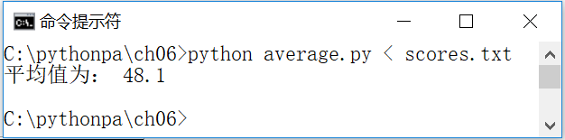
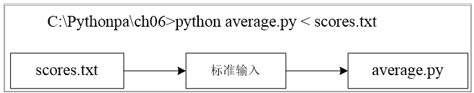
Redirecting files to standard input
Syntax format for input redirection
[Example 6.26] Redirecting files to standard input
Command line commands: python average.py < scores.txt
Diagram of redirecting a file to standard input

Slide 38

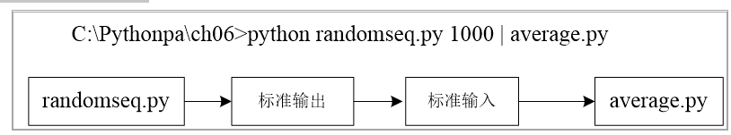
plumbing
The mechanism of connecting the standard output of one program to the standard input of another program is called piping. Example:
Schematic diagram of pipeline execution
c:\pythonpa\ch06> python randomseq.py 1000 | python average.py
The result of its execution is equivalent to the following two lines of the Execute command:
c:\pythonpa\ch06> python randomseq.py 1000 > scores.txt
c:\pythonpa\ch06> python average.py < scores.txt

Slide 39
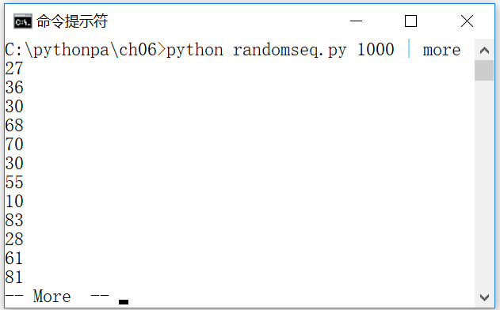
(machine) filter
Filters convert standard input streams to standard output streams in some form or another
[Example 6.27] Filter Example 1: Displaying Data Screen-by-Screen Using the Operating System Utility MORE
Command line commands: python randomseq.py 1000 | more

Slide 40
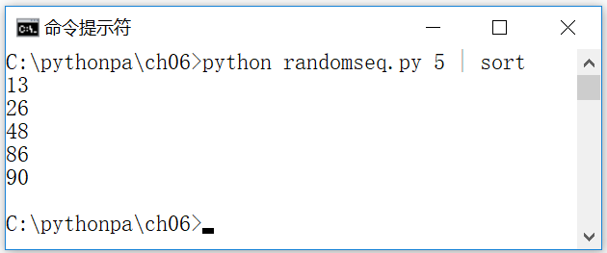
Filter example (1)
[Example 6.28] Filter Example 2: Sorting Output Data Using the Operating System Utility Sort
Command line commands: python randomseq.py 5 | sort

Slide 41
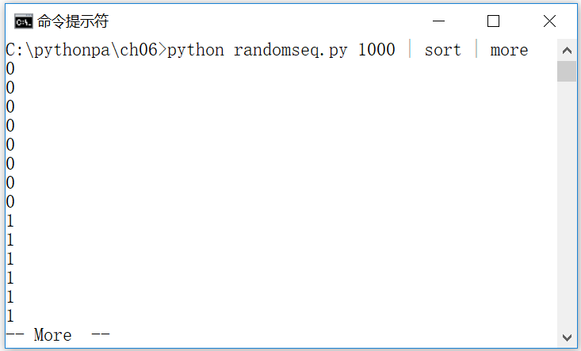
Examples of filters (2)
[Example 6.29] Filter Example 3: Sorting and outputting data screen by screen using the operating system utilities sort and more
Command line commands: python randomseq.py 1000 | sort | more

Slide 42
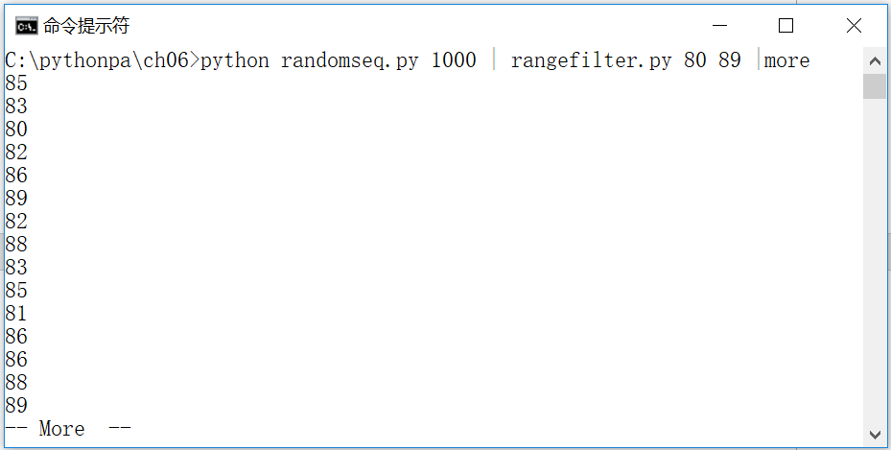
Examples of filters (3)
Example 6.30: Filter Example 4 (rangefilter.py): Writes values from standard input that fall within a specified range to standard output.
import sys
lo = int(sys.argv[1])
hi = int(sys.argv[2])
for line in sys.stdin:
value = int(line)
if (value >= lo) and (value <= hi).
print(str(value))

Slide 43
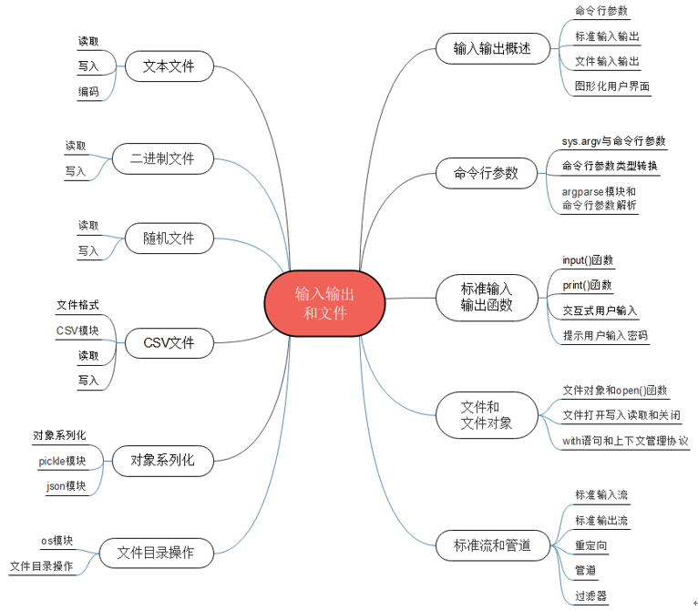
Summary of the chapter

Slide 44
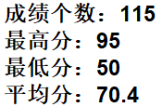
Integrated Application: [Example 6.31] Counting Student Grade Information Stored in a Text File (process_txt.py)
Read the data in data.txt (assuming a number of grades are stored in the file, one grade per line) and statistically analyze the number of grades, highest, lowest, and average scores, and write the results to the results.txt file
scores = [] #Create a list to store scores information
txtfilepath = 'data.txt' #Specify the source data file (raw grade information)
with open(txtfilepath, encoding='utf-8') as f: #open the file
for s in f.readlines(): # read and iterate through the file lines
scores.append(int(s)) #convert data to integer and add to scores list
result_filepath = 'result.txt' #Specify the result data file (performance statistics)
with open(result_filepath,'w', encoding='utf-8') as f: #open file (write mode, specify encoding)
f.write("Number of scores: {}\n".format(len(scores)))
f.write("Maximum score: {}\n".format(max(scores)))
f.write("Minimum score: {}\n".format(min(scores)))
f.write("Average score: {}\n".format(sum(scores)/len(scores)))

Slide 45

Integrated Application: [Example 6.32] Counting weather temperature information stored in a text file (process_temp.py)
Find the hottest day in December (by highest temperature)? What was the maximum temperature and what was the coldest day in December (in terms of minimum temperature)?
How many degrees is the coldest? Calculate the average temperature for the month of December (the average of the highest and lowest temperatures for each day of the month, rounded to the nearest whole number).
It is assumed that in the meteorological sense, the criterion for the beginning of winter is that the average daily temperature is below 10°C for five consecutive days, and the first day thereof is the first day of winter.
Based on the meteorological data of December, determine on which day winter started in Shanghai (for the first day of winter)
txtfilepath = 'temperatures12.txt' #specify data file (raw temperature information)
with open(txtfilepath, encoding='utf-8') as f: #Open the file (text read mode)
ts = f.readlines() #read all contents of the temperature file
temp_high = [int(t1) for t1 in ts[0].strip().split(",")] #list of highest temperatures
temp_low = [int(t1) for t1 in ts[1].strip().split(",")] #list of lowest temperatures
ht = max(temp_high) #maximum temperature
ht_loc = temp_high.index(ht) + 1 # date where the highest temperature is located
lt = min(temp_low) #minimum temperature
lt_loc = temp_low.index(lt) + 1 # date where the lowest temperature is located
print(f "December {ht_loc} was the hottest, with a maximum temperature of {ht}")
print(f "December {lt_loc} was the coldest, with a minimum temperature of {lt}")
#Build a list of average daily temperatures
temp_average = [(temp_high[i] + temp_low[i])/2 for i in range(len(temp_high))]
# Construct a list of average daily temperatures below 10 degrees (value 1 if below 10 degrees, value 0 otherwise)
t10 = [int(t<10) for t in temp_average]
# (for lists of 1 and 0) Summary of 5 consecutive days with average daily temperatures below 10 degrees
t10_m = [t10[i]+t10[i+1]+t10[i+2]+t10[i+3]+t10[i+4] for i in range(len(t10)-4)]
# First aggregated value of 5 consecutive days with average daily temperatures below 10 degrees (that's 5)
t10_5 = max(t10_m)
# Date on which the first aggregated value of 5 consecutive days with an average daily temperature below 10 degrees is located
t10_5_loc = t10_m.index(t10_5) + 1
print(f "Winter started in Shanghai on December {t10_5_loc}, the first day of winter")

Slide 46
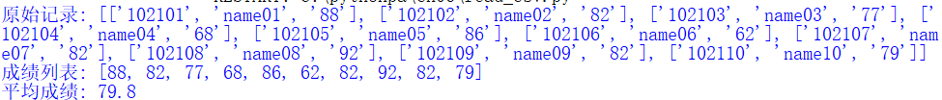
Comprehensive application: [Example 6.33] Counting student grade information stored in a CSV file (read_csv.py)
Assuming that the data.csv file holds information about the student's academic number (ID), name and grade (score) for a number of students.Write a program to read the information in data.csv, get information about students' grades, and statistically analyze the average of students' grades
import csv #import module
scores = [] #create a list to store the scores read from the csv file
csvfilepath = 'data.csv' #Specify the data file (raw grade information)
with open(csvfilepath, newline='') as f: #Open the file (text read mode)
f_csv = csv.reader(f) #create csv.reader object
headers = next(f_csv) #header information
for row in f_csv: # Loop through the rows and print them.
scores.append(row)
print("Raw records:", scores)
scoresData = [] #Create a list to store statistics on scores
for rec in scores: # Loop through the list of grade records (number, name, grade)
scoresData.append(int(rec[2])) #form a list of student scores
print("List of grades:",scoresData) #Output the list of student grades
print("Average grade:",sum(scoresData)/len(scoresData)) #Output average grade

Slide 47
Comprehensive application: [Example 6.34] Dictionary-based address book (addressbook.py)(1)
"""Simple address book program""""
import os, json
ab = {} #Addresses are stored in the dictionary name:tel
# Read address book from JSON file
if os.path.exists("addressbook.json"):.
with open(r'addressbook.json', 'r', encoding='utf-8') as f.
ab = json.load(f)
while True:
print("|---Welcome to the Address Book program---|")
print("|---1: Displaying the list of address books ---|")
print("|---2: Query contact information ---|")
print("|---3: Insert new contact ---|")
print("|---4: Delete existing contact ---|")
print("|---0: Exit -------------|")
choice = input('Please select function menu (0-4):')
if choice == '1'.
if(len(ab)==0).
print("Address book is empty")

Slide 48
Comprehensive application: [Example 6.34] Dictionary-based address book (addressbook.py) (2)
else.
for k, v in ab.items():
print("Name={},Contact number={}".format(k, v))
elif choice == '2'.
name = input("Please enter a contact name:")
if(name not in ab).
ask = input("Contact does not exist, add user profile (Y/N)")
if ask in ["Y", "y"].
tel = input("Please enter the user's contact phone number:")
ab[name] = tel
else.
print("Contact info: {} {}".format(name, ab[name]))
elif choice == '3'.
name=input("Please enter a contact name:")
if(name in ab).
print("Contact already exists: {} {}".format(name, ab[name]))
ask = input("Whether to change user profile (Y/N)")

Slide 49
Comprehensive application: [Example 6.34] Dictionary-based address book (addressbook.py) (3)
if ask in ["Y", "y"].
tel = input("Please enter the user's contact phone number:")
dict[name] = tel
else.
tel = input("Please enter the user's contact phone number:")
ab[name] = tel
elif choice == '4'.
name = input("Please enter a contact name:")
if(name not in ab).
print("Contact does not exist: {}".format(name))
else.
tel = ab.pop(name)
print("Delete contact: {} {}".format(name, tel))
elif choice == '0': #save to JSON file and exit loop
with open(r'addressbook.json', 'w', encoding='utf-8') as f.
json.dump(ab, f)
break

Slide 50
Case Study: Blackjack Card Game
This chapter's case study helps the reader further understand the use of data structures and algorithms to implement basic game AI using a slightly more complex game case study that implements human-computer dialog interaction features.
"Blackjack, also known as Blackjack, is a popular poker game. The game is played by two to six players, using 52 cards except for the king and queen, and the player's goal is to make the sum of the cards in his hand as large as possible without exceeding 21 points.
The rules for calculating the number of points in a hand of poker are as follows: 2 to 9 cards are counted as their original number of points; 10, J, Q, K cards are all counted as 10 points (usually recorded as T, i.e., Ten); Ace can be counted as either 1 or 11 points, at the discretion of the player (when a player stops a hand, the number of points is considered to be the maximum and try not to explode, e.g., A+K is 21, A+5+8 is 14, not 24). )
The solution and source code etc. of the case studies are provided in electronic format, please scan the QR code in the tutorial for details

Slide 51
Blackjack Card Game Design Ideas
Computer Artificial Intelligence AI as a Banker (House) and Users as Players (Player)
At the start of the game, the dealer deals cards from a shuffled deck: the first card is dealt to the player, the second card is dealt to the dealer, the third card is dealt to the player, the fourth card is dealt to the dealer
Then, the player is asked if he wants to continue to "take cards", and by taking one or more "takes", the player tries to bring the sum of the cards in his hand closer to 21. if the sum of the cards in the player's hand exceeds 21, the player loses!

Slide 52
Blackjack Card Game Design Ideas
When a player decides to "stop" (i.e., not to "take a hand"), it is the dealer's turn to "take a hand" using the following rules (the "dealer rules"): if the sum of the best points in the dealer's hand is less than 17, he must "take a hand"; if the sum of the points is greater than or equal to 17, he "stops". ": If the sum of the best points in the dealer's hand is less than 17, he must "take"; if the sum of the points is greater than or equal to 17, he "stops". If the sum of the dealer's points exceeds 21, the player wins!
Finally, the points of the player and the dealer are compared. If the player has more points, he wins. If the player has a small number of points, he loses. If the number of points is the same, it is a tie. However, if both the player and the dealer's cards are worth 21 points, the player with the blackjack (an ace and a 10) wins!

Slide 53
Flow of the program
(1) Initialize a shuffled deck of playing cards (call the function get_shuffled_deck()), initialize the dealer's and player's hands to be empty
(2) Deal two cards each to the player and the dealer in turn (call function deal_card())
(3) Player take card: ask the player whether to continue to take the card, if yes, continue to deal the card to the player (call function deal_card()), and calculate the player card point, if greater than 21 points, output "Player loses!" message, and return
(4) The dealer takes the card: the dealer (computer artificial intelligence AI) according to the "dealer rules" to determine whether to take the card, if so, continue to deal cards to the dealer (call the function deal_card()), and calculate the dealer card point, if greater than 21 points, output "the player wins the card! " message, and return
(5) Calculate the points of the banker and the player respectively, compare the size of the points, and output the winning and losing result information.

Slide 54
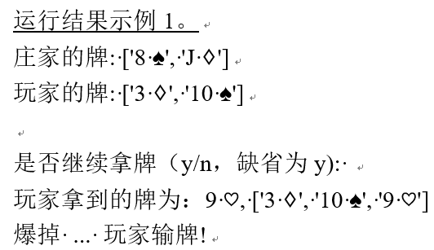
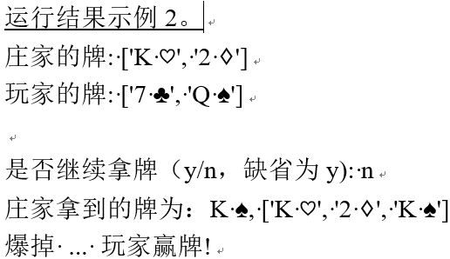
[Example CS6.1] Blackjack poker game sample program (blackjack.py)

Slide 55
Thank!

